Slide 1
Youth Engagement in Tobacco Control and Point of Sale

Slide 2
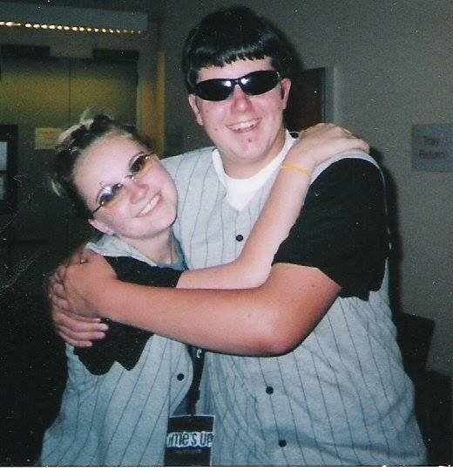
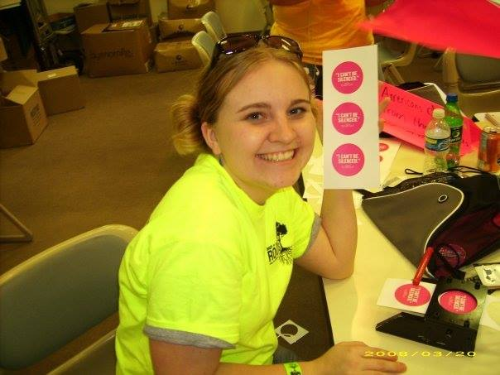
My Background & Experience
Youth – High School
Young Adult - College
State Youth Coordinator
Robbyn Duchow, RD Consulting

Slide 3
30 members (2013) – 2500 members (2017)
Robbyn Duchow, RD Consulting

Slide 4
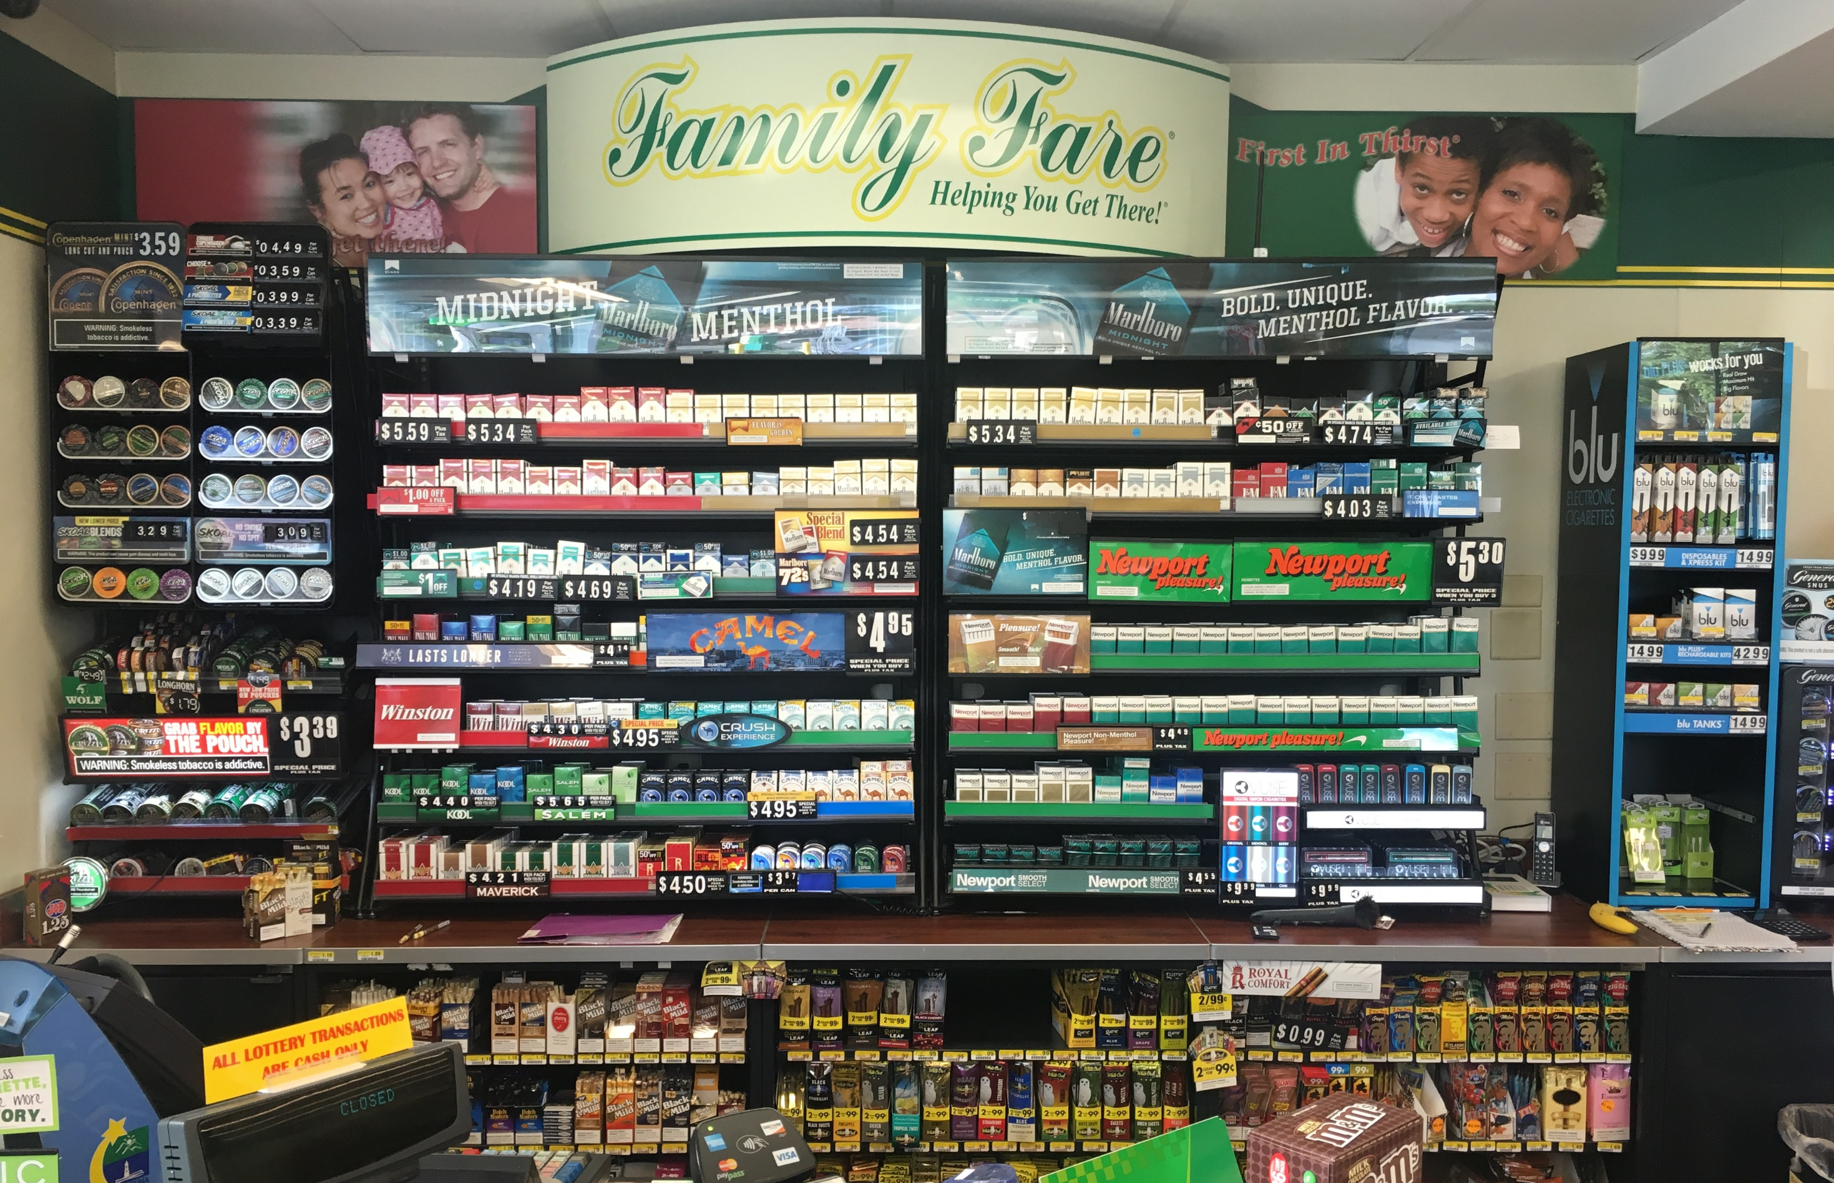
"Family Fare Powerwall" Taken May 6, 2016, in Chapel Hill, NC by Kurt Ribisl
Robbyn Duchow, RD Consulting
Notes:
2004, Operation Storefront, Advertising Indoors/Outdoors, 3ft
2004 report: “Nationally, tobacco surveillance research has noted that retail stores in the south and in rural areas have a tendency to have lower prices and a greater amount of advertising and marketing” – 2004 after the master settlement agreement: trends in the American tobacco retail environment 1999-2002. In 1998 the MSA restricted many of the main tobacco companies marketing avenues, but the MSA left the retail setting largely untouched. In fact, the retail environment has been the highest spending category for tobacco industry marketing. In 1998, I was right at the age of initiation. The 7 years after the MSA (1998-2005), marked a sharp increase in tobacco industry marketing in the retail environment. By 2005 (HS graduation), the tobacco industry spent nearly 90% of it’s marketing budget in the retail environment with the greatest spending increase in price discounting. Then in 2009, the Family Smoking Prevention and Tobacco Control Act passed, and this allowed state & local govt to complement their existing policies with tobacco control legislation restricting time, place, and manner (but not the content) of cigarette advertising and promotion.

Slide 5
Legacy Youth Leadership Institute, July 2013
Robbyn Duchow, RD Consulting

Slide 6
Robbyn Duchow, RD Consulting

Slide 7
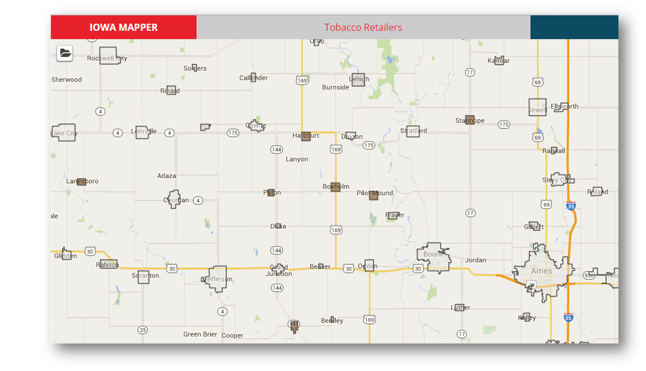
Robbyn Duchow, RD Consulting

Slide 8
Robbyn Duchow, RD Consulting

Slide 9
Q: Why focus on youth when doing POS?
Q: What about the data? Don’t you want consistent data? What if youth mess up?
Q: Where do I start when doing POS with Youth?
Robbyn Duchow, RD Consulting

Slide 10
Q: How do I get youth interested in going into the stores to do POS in the first place?
Q: How do you get youth engaged further in action planning around POS?
Q: How do I create/find a group of youth to do POS?
Robbyn Duchow, RD Consulting

Slide 11
Point of Sale

Slide 12
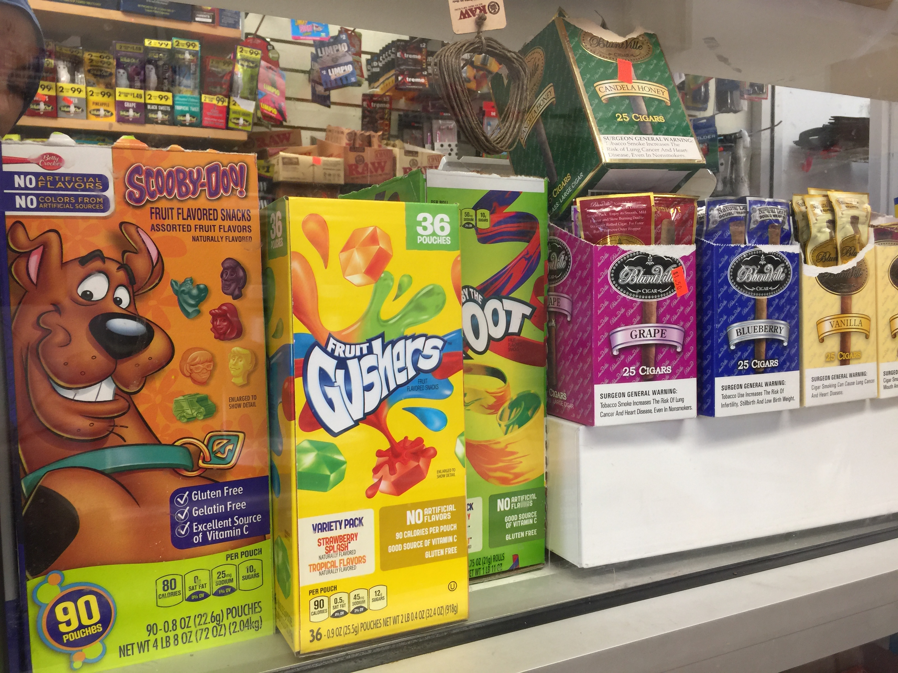
"Cigars on display (not self-service) next to candy in a Columbia Heights convenience store" Taken February 22, 2017 in Columbia Heights, Washington D.C. by Ann Boonn
Robbyn Duchow, RD Consulting

Slide 13
"Cherry Skoal is for somebody who likes the taste of candy, if you know what I’m saying...“
US Smokeless Tobacco
Robbyn Duchow, RD Consulting

Slide 14
Robbyn Duchow, RD Consulting

Slide 15
“…The package design should be geared to attract the youthful eye… not the ever-watchful eye of the Federal Government.”
Lorillard
Robbyn Duchow, RD Consulting

Slide 16
Robbyn Duchow, RD Consulting

Slide 17
Electronic Smoking Devices

Slide 18
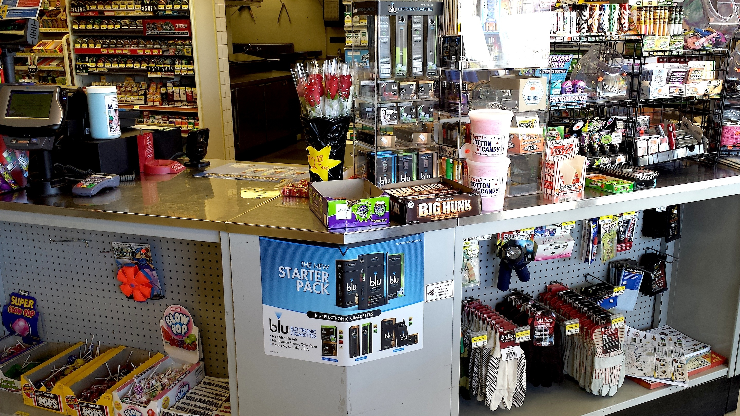
Blu Electronic Cigarettes Advertisement Near Candy in Store Display" Taken September 25, 2013, by Ashley Richter in Bellefonte, AR
Robbyn Duchow, RD Consulting

Slide 19
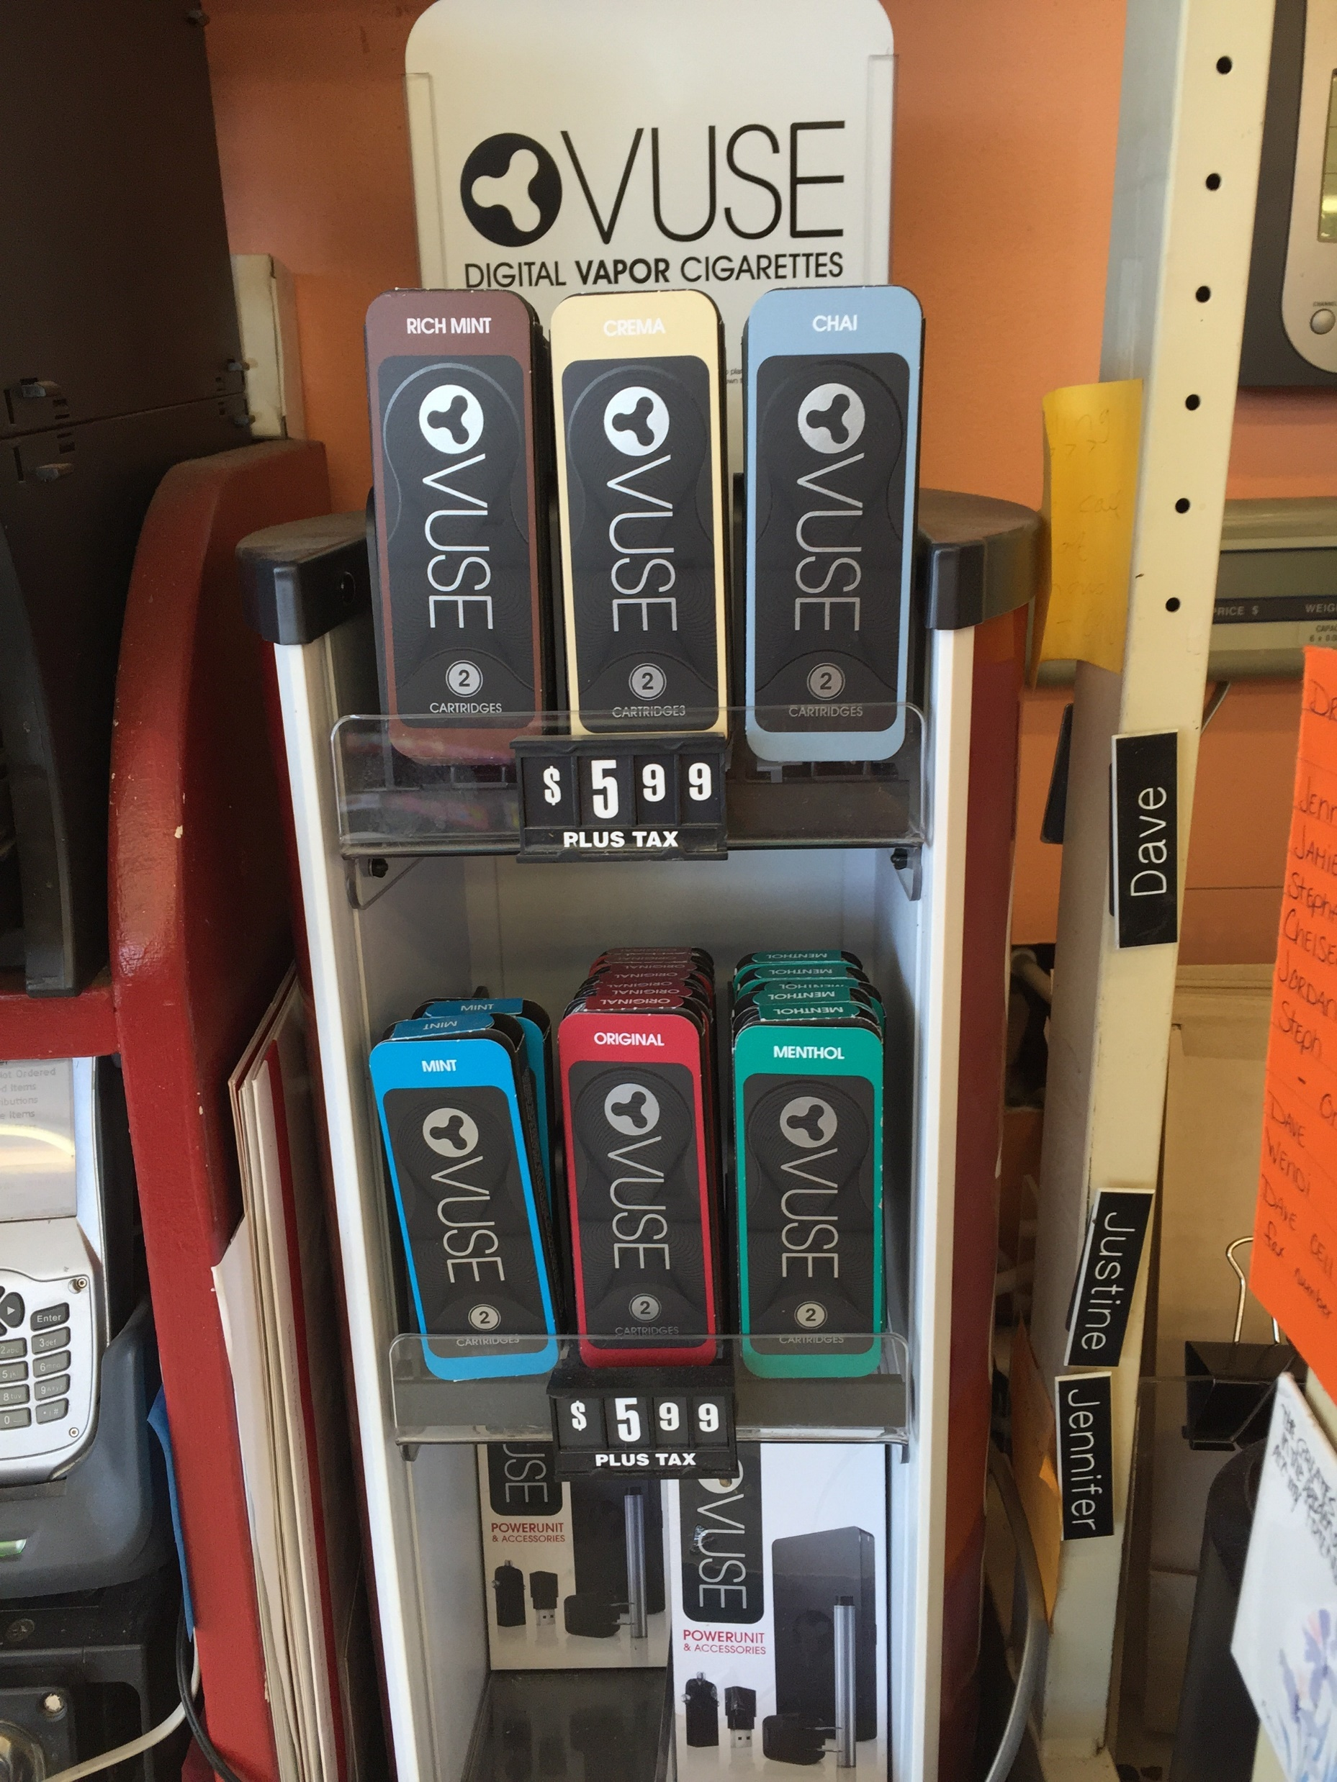
"Vuse flavor cartridges" Taken March 14, 2015, by Katie Byerly in Moab, UT
Robbyn Duchow, RD Consulting

Slide 20
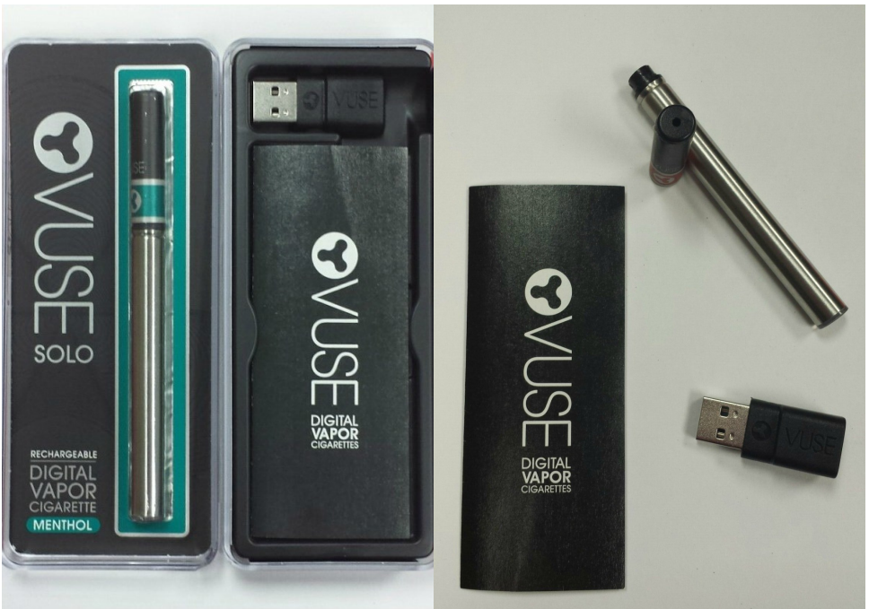
Robbyn Duchow, RD Consulting

Slide 21
Robbyn Duchow, RD Consulting

Slide 22
Robbyn Duchow, RD Consulting

Slide 23
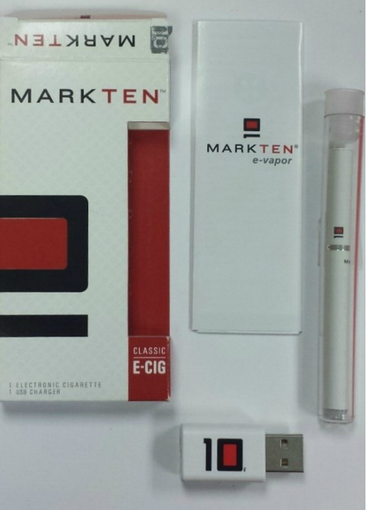
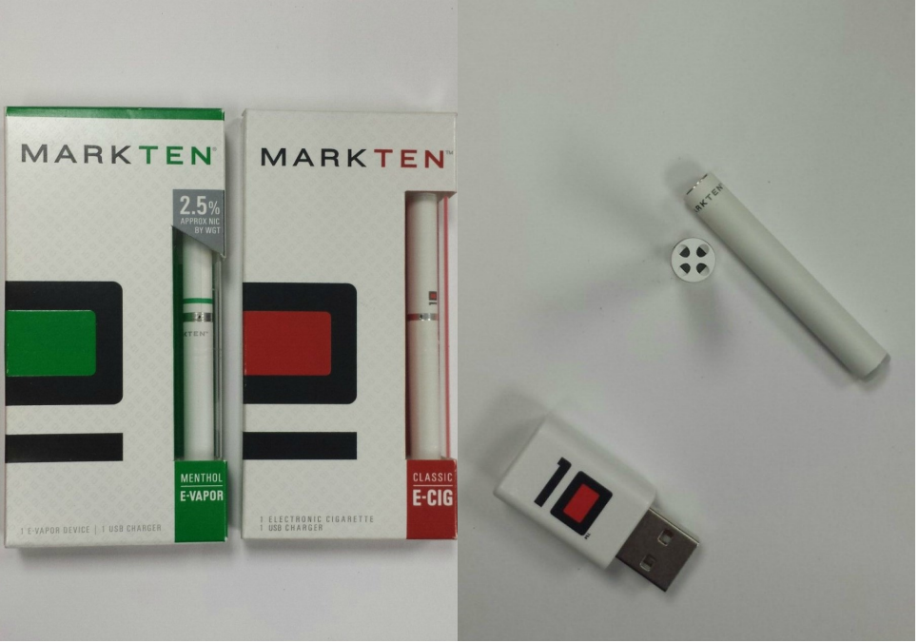
Robbyn Duchow, RD Consulting

Slide 24
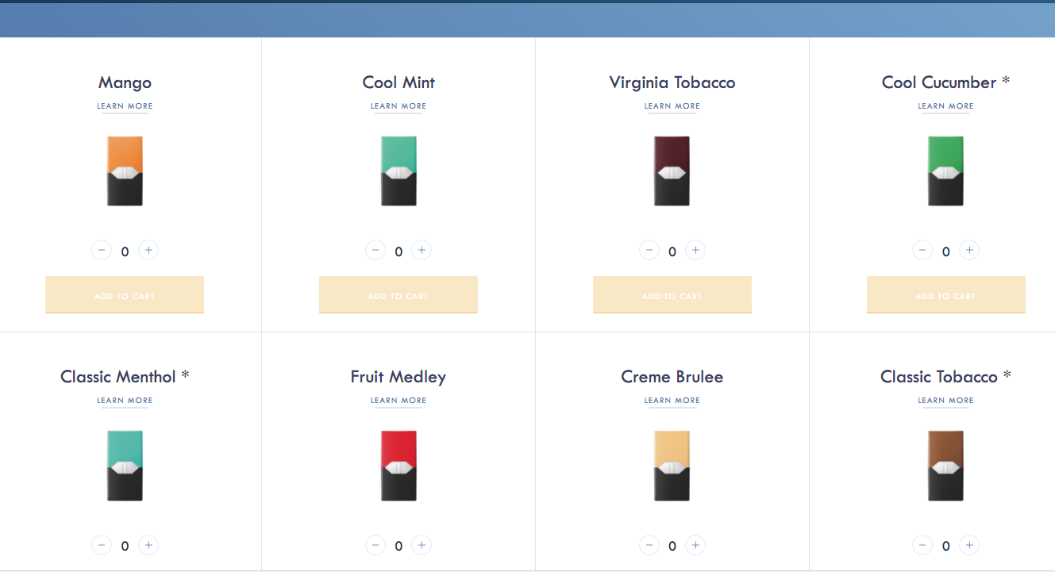
Robbyn Duchow, RD Consulting

Slide 25
Electronic Smoking Devices and Youth

Slide 26
Robbyn Duchow, RD Consulting

Slide 27
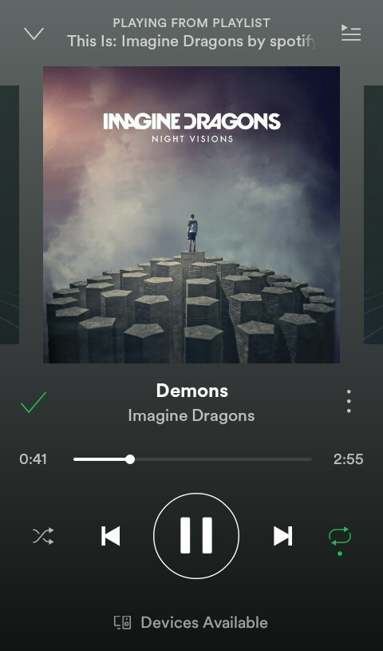
Robbyn Duchow, RD Consulting

Slide 28
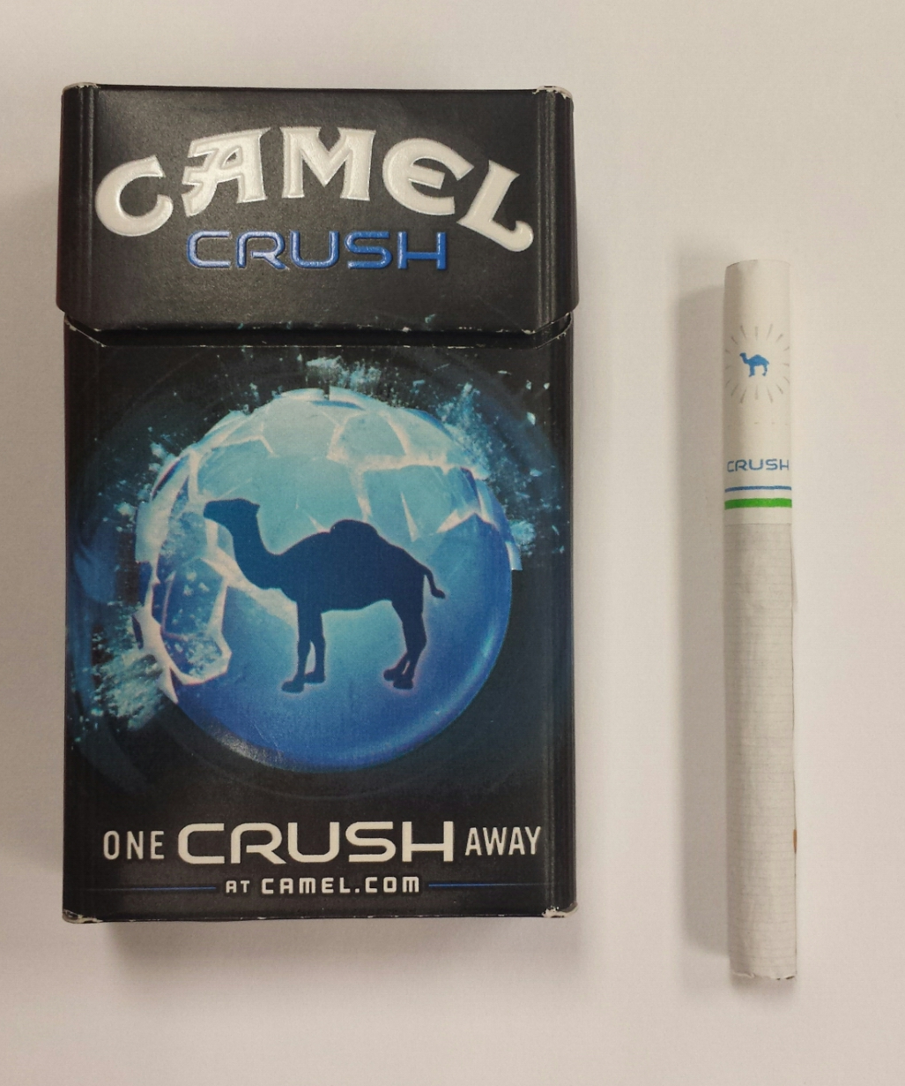
Robbyn Duchow, RD Consulting

Slide 29
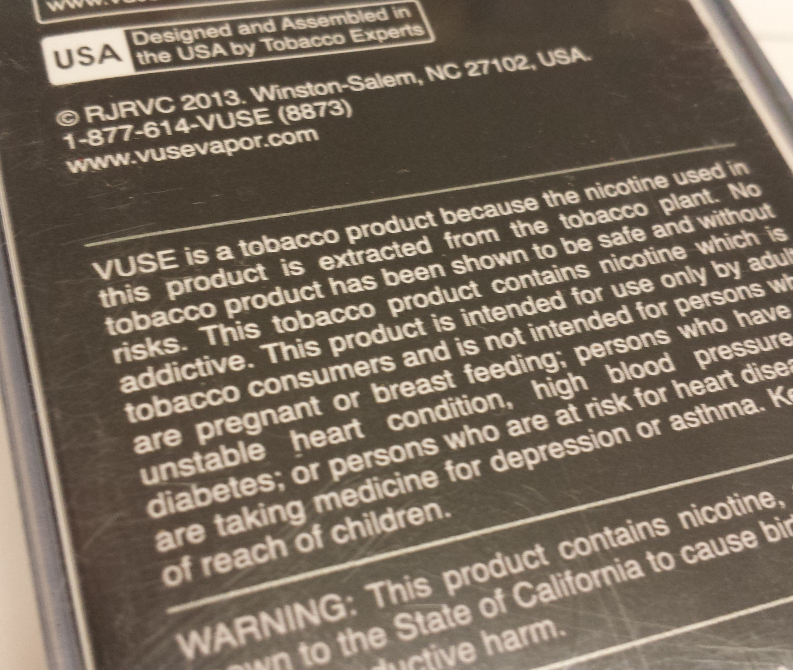
Robbyn Duchow, RD Consulting

Slide 30
Robbyn Duchow, RD Consulting

Slide 31
Robbyn Duchow, RD Consulting

Slide 32
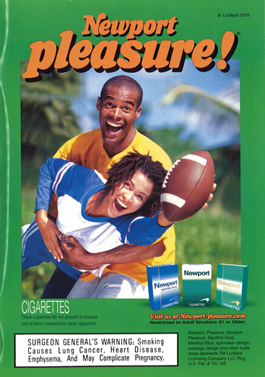
Robbyn Duchow, RD Consulting

Slide 33
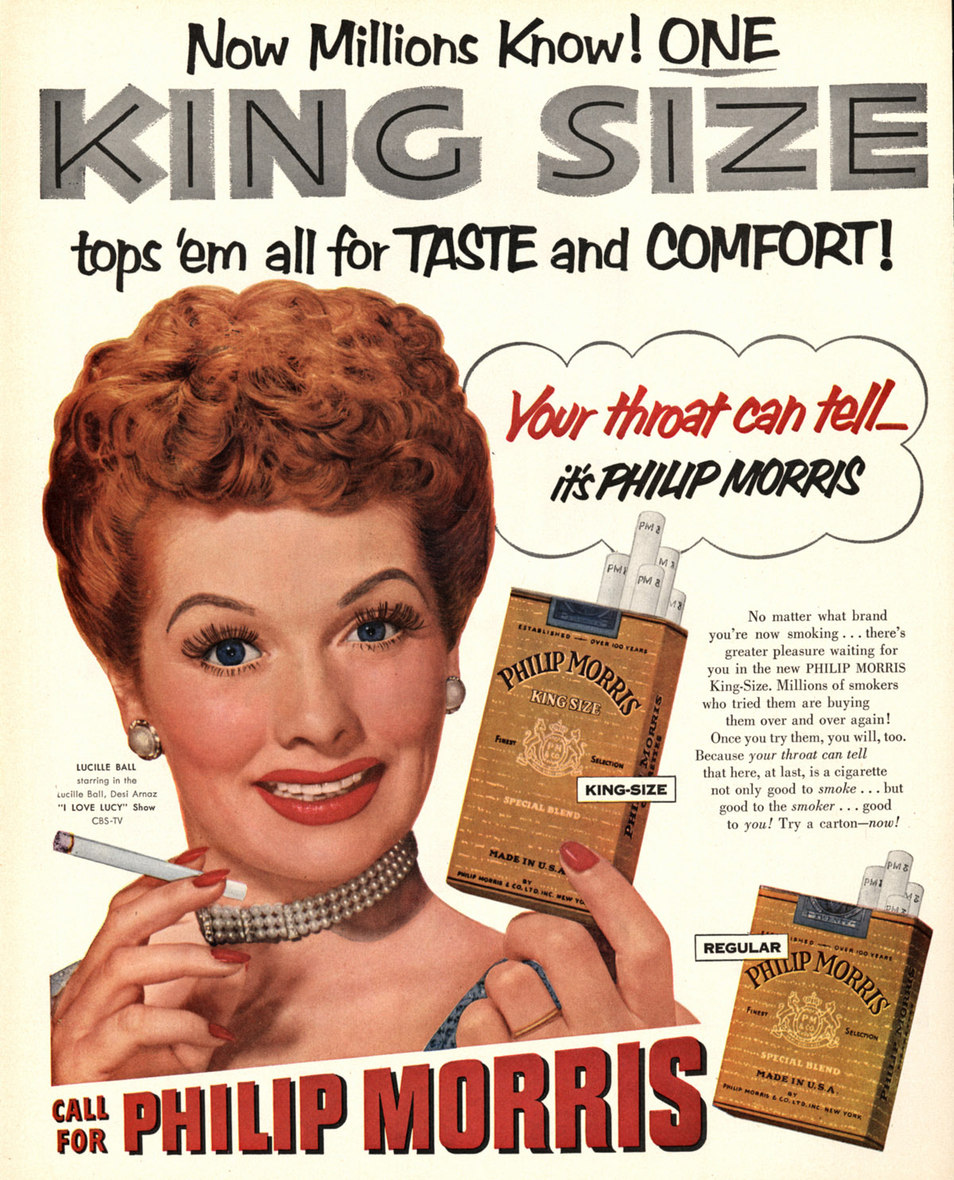
Robbyn Duchow, RD Consulting

Slide 34
TIPS:
*Know your New Products
*Know the brands/types of ESD
*Know the HISTORY of the ESD, company names
*Know your tobacco advertising
*Know your industry documents
*Know traditional TOBACCO products
*Know your audience
*Know your Community/State and the Mapper
Robbyn Duchow, RD Consulting

Slide 35
Questions & Answers

